Slide 1
Exploring transcriptional networks for microglia and oligodendrocytes
Elijah Blige

Slide 2

Presenilin-1 (PSEN1) contributes to the cleavage of APP
Mutations in PSEN1 are associated with AD pathogenesis
Inhibition of γ-secretase caused increased expression related to damage associated microglia (DAM)

Slide 3

How do these variants affect cellular transcriptional states?
Specific transcriptional states are associated with carrier status

Slide 4
Plan for rotation
Study transcriptional networks on microglia
Focus on PSEN1 and any networks that include PSEN1
Identify any PSEN1 substrates found in networks with PSEN1 (that is not APP)

Slide 5

Used to construct a co-expression network for each cell state
Genes that show similar expression patterns are grouped together into modules
Not all genes are assigned to a module
Investigate PSEN-1 assigned modules for each cell state

Slide 6
Structure overview
Microglia
Micro-1
Micro-2
Micro-3
Module 3
Module 1
Module 2
Module 3
Module 1
Module 2
Module 3
Module 1
Module 2
Cell Type
Cell State
hdWGCNA modules
PSEN-1
PSEN-1

Slide 7
PSEN1 modules for transcriptional states
Assigned | Not Assigned | Too few cells
Micro-3 | Micro-0 | Micro-5
Oligo-1 | Micro-1 | Micro-6
Oligo-2 | Micro-2 | Micro-7
Oligo-3 | Micro-4 | Micro-8
Oligo-4 | Oligo-0
Oligo-5
Oligo-6
Oligo-7
Oligo-8

Slide 8
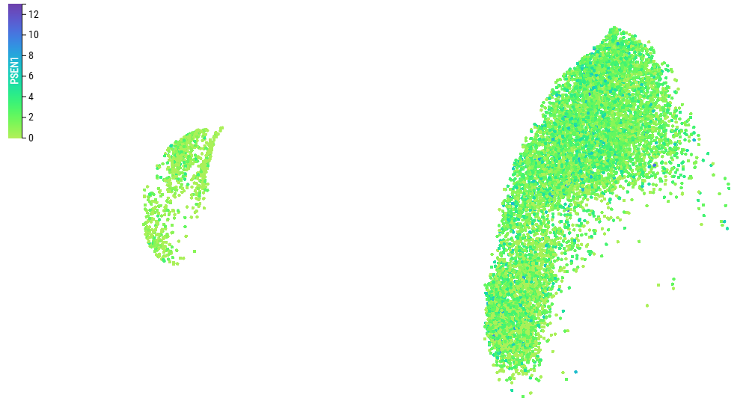
Why Oligodendrocytes
Microglia
Oligodendrocytes

Slide 9
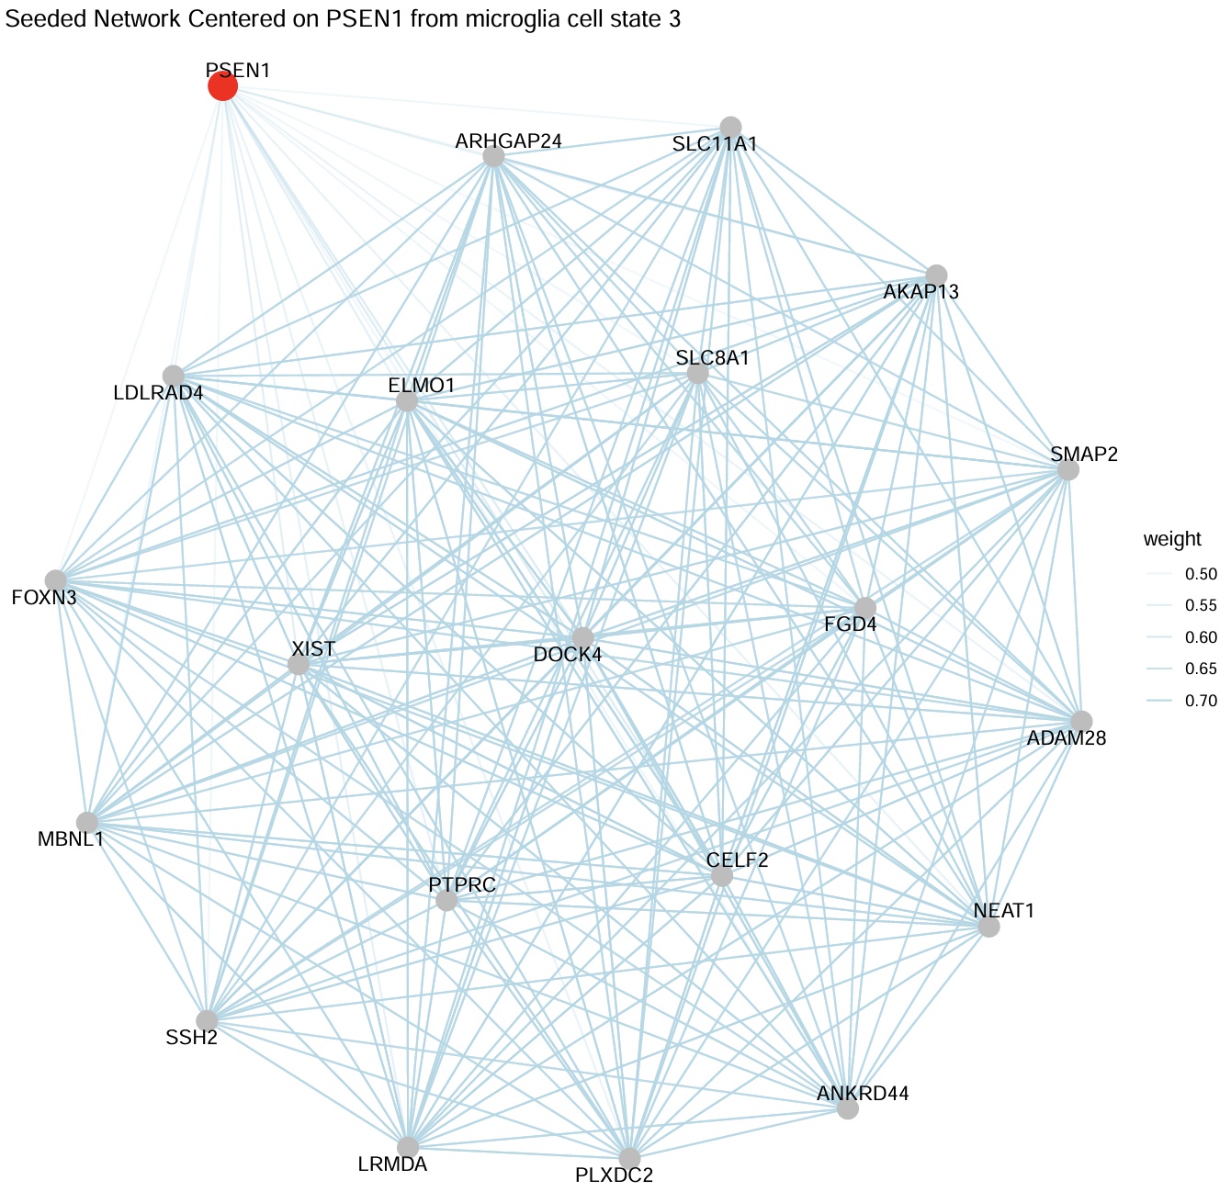

Slide 10
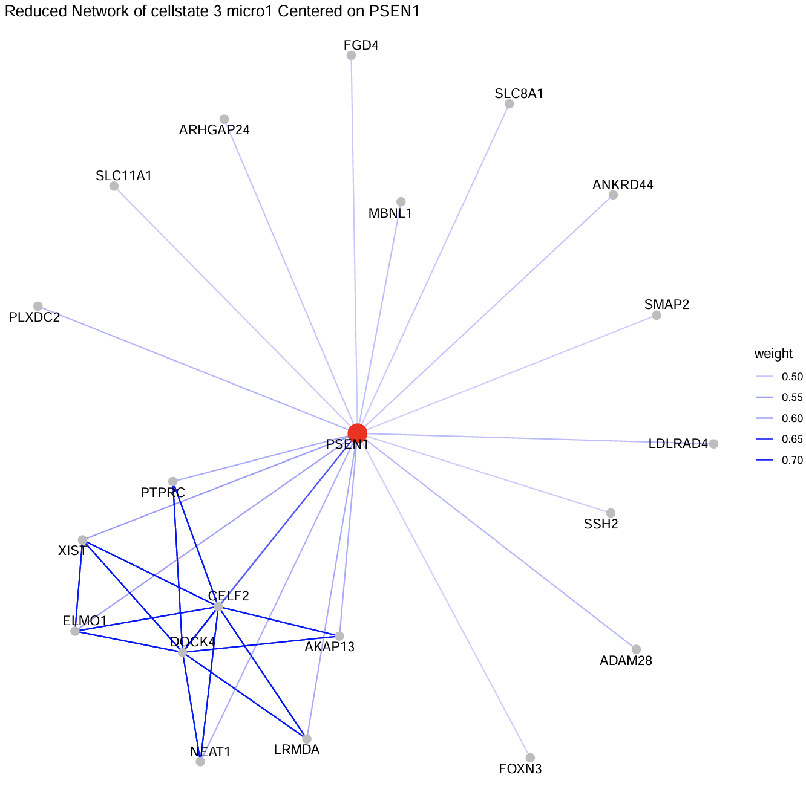

Slide 11
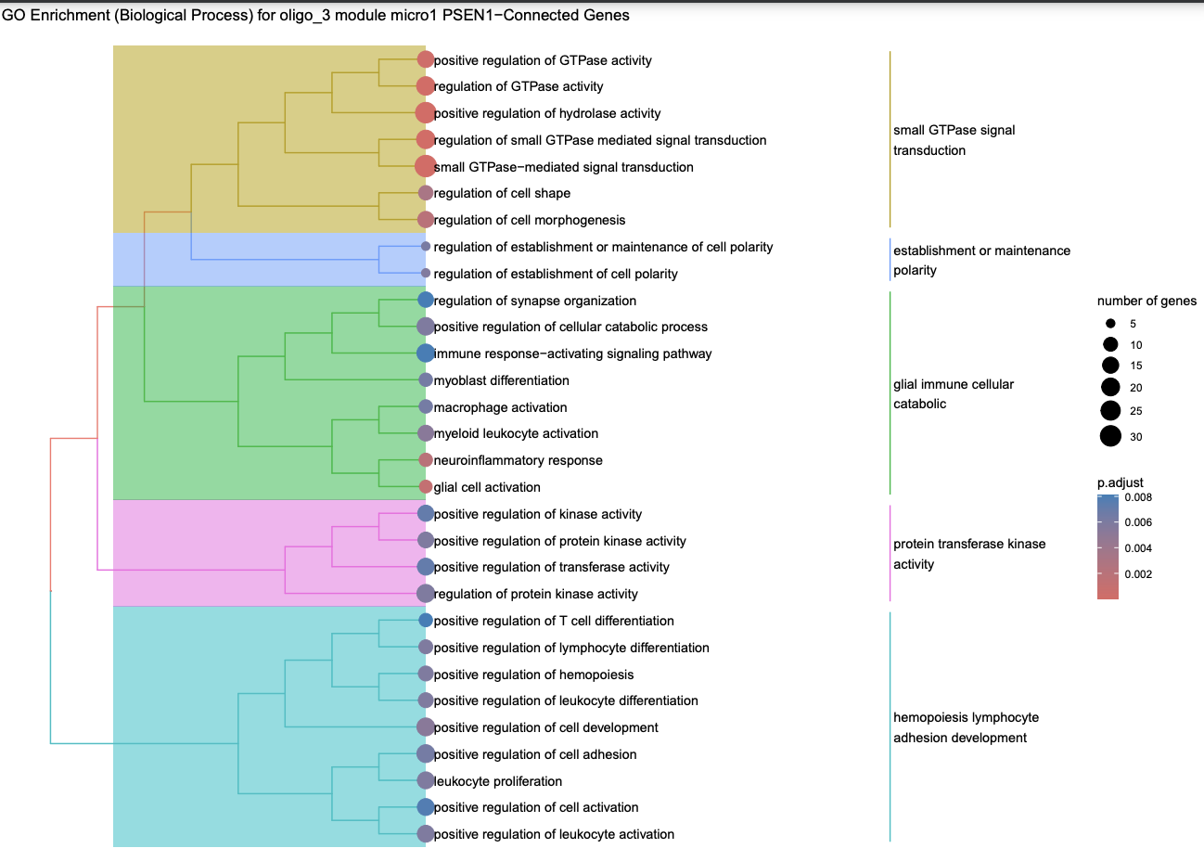

Slide 12
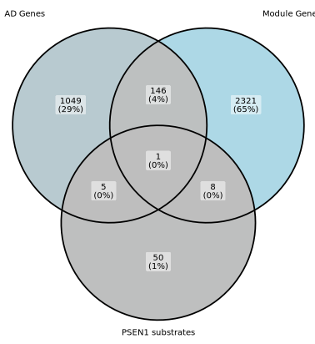
Module genes vs PSEN1 substrates and AD genes
ACP2 was assigned to the same module as PSEN1
ACP2 is a known substrate of PSEN1
ACP2 is associated with AD pathogenesis

Slide 13
Future Direction
Module preservation vs comparison
Finish analyzing oligodendrocyte modules
Validate with Australian dataset
Investigate the role of ACP2 cleavage in AD pathogenesis
Comparisons between statuses

Slide 14
What I learned
hdWGCNA
WGCNA
How to navigate complicated dependency issues when building an environment
The value of “bad” ideas

Slide 15
Thank you to Harari lab

